Slide 1
Module IV
Decision Trees and Random Forests
True/False decisions
Random Forests as collections of Decision Trees
Source: color box.com, DHgate, quora.com, medium.com
Source: PBS, Medical Daily

Slide 2
Revisiting the Titanic disaster with less data
Training data
 | Sex | Pclass | Survived
1 | 2 | 3 | 0
2 | 1 | 3 | 0
3 | 1 | 3 | 0
4 | 1 | 3 | 0
5 | 1 | 1 | 1
6 | 2 | 1 | 0
7 | 1 | 2 | 1
8 | 2 | 1 | 1
9 | 2 | 3 | 0
10 | 2 | 3 | 1
11 | 2 | 3 | 1
12 | 2 | 3 | 0
Who survived?
Who did not?

Slide 3
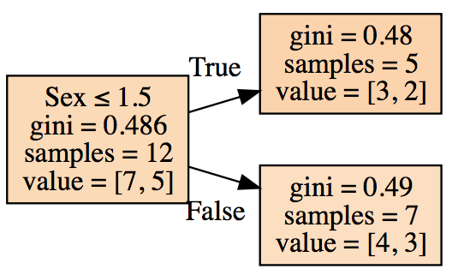
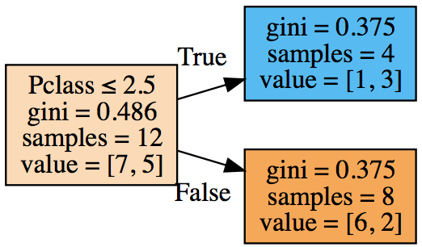
How to grow your own decision tree: Step 1
Identify feature to make first branch split
Sorted first by column
‘Sex’
Sorted fist by column
‘Pclass’
 | Sex | Pclass | Survived
1 | 2 | 3 | 0
6 | 2 | 1 | 0
8 | 2 | 1 | 1
9 | 2 | 3 | 0
10 | 2 | 3 | 1
11 | 2 | 3 | 1
12 | 2 | 3 | 0
2 | 1 | 3 | 0
3 | 1 | 3 | 0
4 | 1 | 3 | 0
5 | 1 | 1 | 1
7 | 1 | 2 | 1
 | Sex | Pclass | Survived
1 | 2 | 3 | 0
9 | 2 | 3 | 0
10 | 2 | 3 | 1
11 | 2 | 3 | 1
12 | 2 | 3 | 0
2 | 1 | 3 | 0
3 | 1 | 3 | 0
4 | 1 | 3 | 0
7 | 1 | 2 | 1
6 | 2 | 1 | 0
8 | 2 | 1 | 1
5 | 1 | 1 | 1
Pick one with lower Gini

Slide 4


Grow your trees with what?
Gini gain or Entropy gain
Gini measure “impurity”
One class sample has 0 impurity !
Aim at making each split more pure…
Move towards direction of
better gains: Gini/Entropy
Entropy measures how much information is encoded in a decision
Higher gains = better quality decisions
We calculate the probability distributions from frequencies

Slide 5
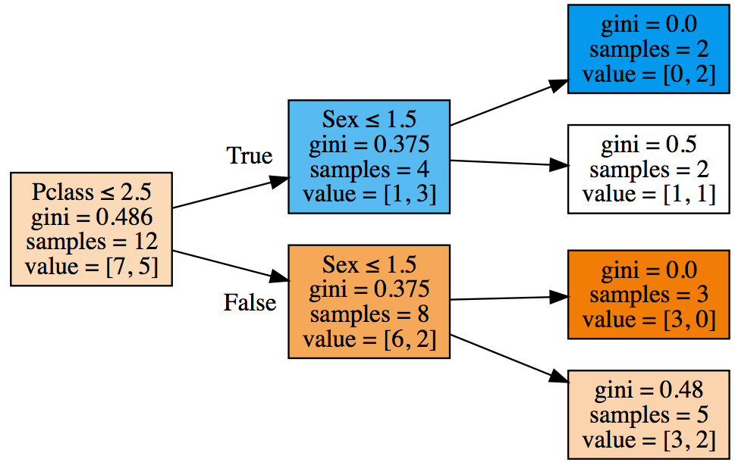
How to grow your own decision tree: Step 2
Then make more branch splits
First sort by Pclass, and then by Sex
 | Pclass | Sex | Survived
1 | 3 | 2 | 0
9 | 3 | 2 | 0
10 | 3 | 2 | 1
11 | 3 | 2 | 1
12 | 3 | 2 | 0
2 | 3 | 1 | 0
3 | 3 | 1 | 0
4 | 3 | 1 | 0
7 | 2 | 1 | 1
6 | 1 | 2 | 0
8 | 1 | 2 | 1
5 | 1 | 1 | 1
Split first by Pclass, then by Sex!

Slide 6
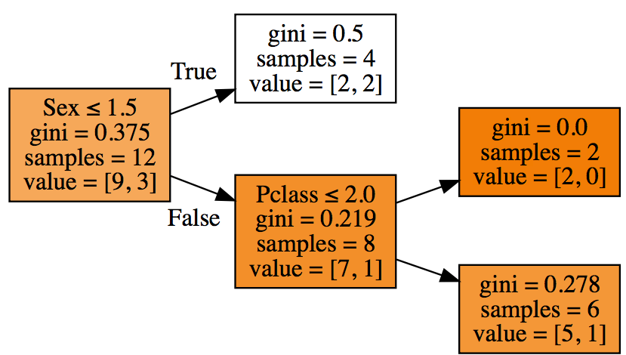
But for another bunch of rows of from the same dataset…
A different decision tree model work best!
 | Sex | Pclass | Survived
1 | 1 | 3 | 0
2 | 2 | 3 | 0
3 | 2 | 1 | 0
4 | 2 | 3 | 0
5 | 2 | 3 | 0
6 | 2 | 3 | 0
7 | 1 | 3 | 1
8 | 2 | 3 | 1
9 | 2 | 3 | 0
10 | 1 | 3 | 1
11 | 2 | 1 | 0
12 | 1 | 3 | 0
The single decision tree model does not generalize well to all rows of data.
Solutions: create separate models for different subsets of data, then average!
For these rows, split first by Sex, then by Pclass!

Slide 7
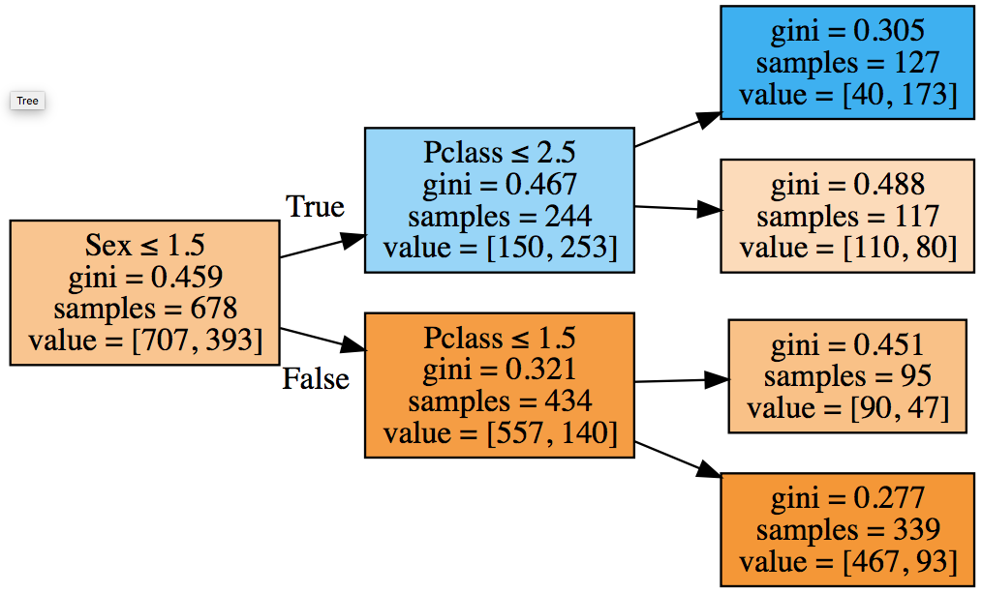
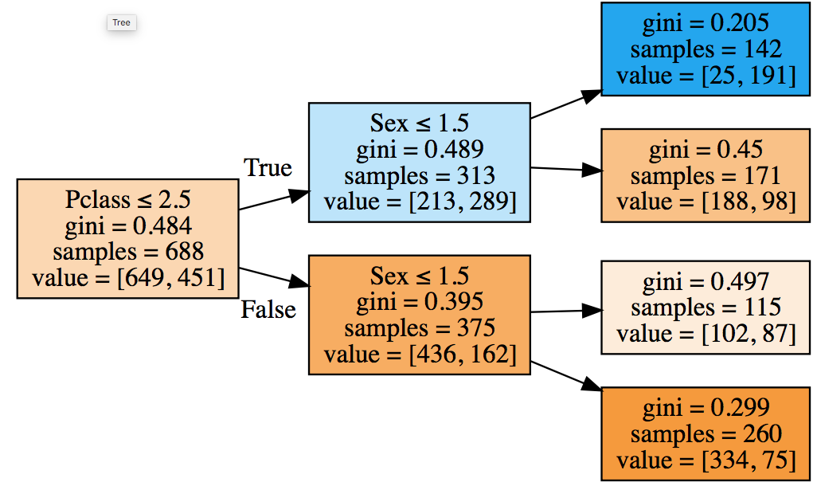
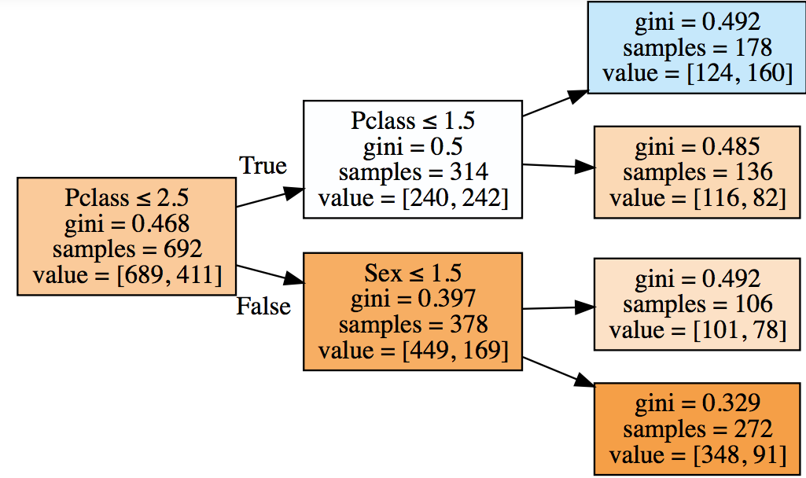
From trees to forests
Implementing decision tree ensembles as Random Forests
Ensemble of decision trees:
Take a bunch of rows, build a decision tree
Put them back, grab another bunch, build decision tree, put them back !
Do the same thing over and over again until required number of trees are built
To predict Y of a new row of data, find similar trees in tree space, average their Y’s!

Slide 8
Bagging trees
source: medium.com/greyatom/

Slide 9
How and why does ensembling work?
Source: kidskunst.info, sightwords.com
Average of guesses is more accurate on average than any single guess!
Any single model (decision tree) will perfectly fit some subset of data
However, it will overfit the entire dataset
Many such weak learning models can be bunched together, to build a strong classifier
Uncorrelated errors tend to cancel out, net error tends to zero…
Each model brings in a different and unique insight into the structure of the data

